Slide 1
Pupil Wellbeing Ambassadors

Slide 2
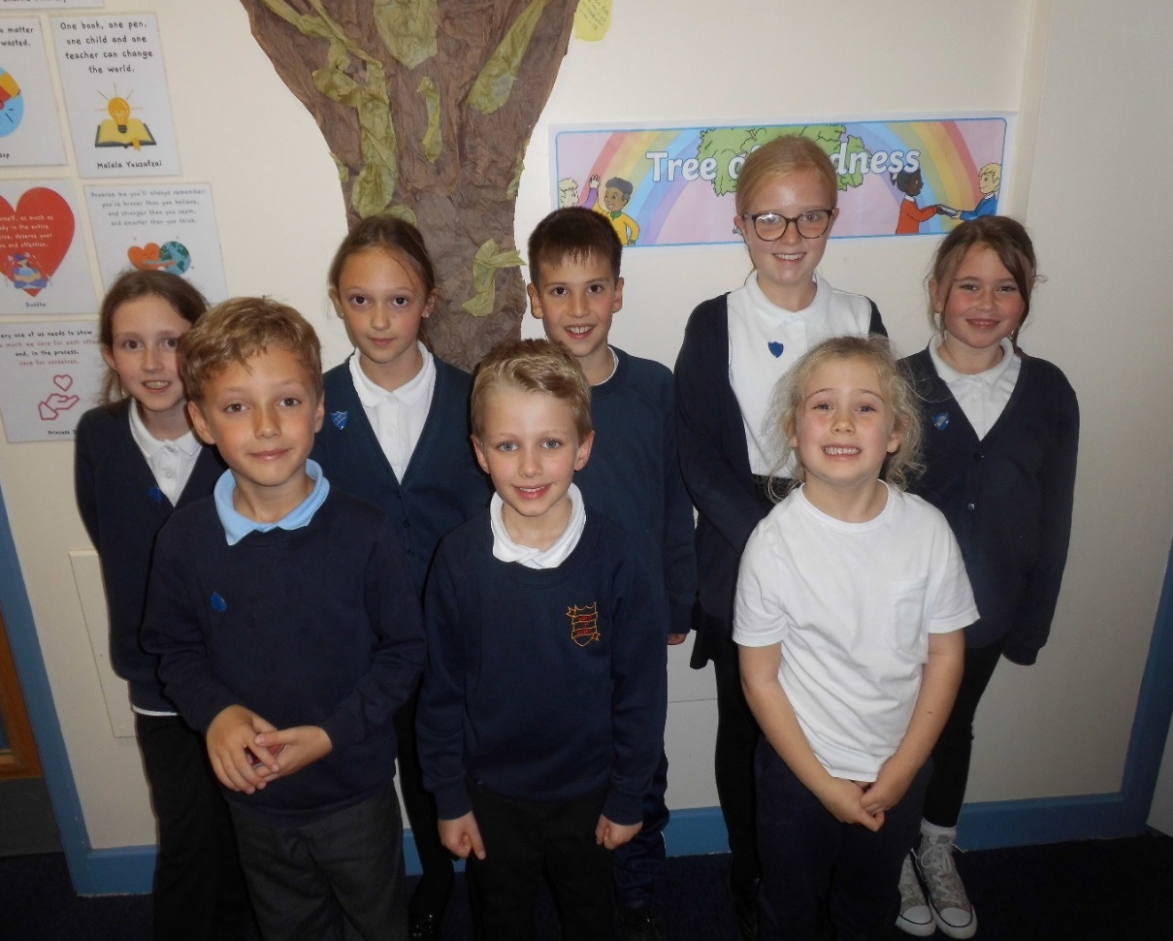
Our Ambassadors
These are pupils who have shown a real interest in championing positive mental health and wellbeing. They were chosen to be outstanding role models around school and to help other children by listening to problems and helping to restore friendships when people have a falling out. These pupils are keen to share their learning around mental health and advertise the importance of self-care. They also look out for children who might not have anyone to play with and try to ensure that everyone is happy in school.
The children apply for the position of wellbeing ambassador by completing a job application form. Our wellbeing ambassadors help to promote the weekly kindness challenge across the whole school, the school kindness tree and also regularly give out random acts of kindness tokens to pupils and staff. They take part in online training and workshops to help develop their role. Our wellbeing ambassadors will be proactive in ensuring that Barlby CP school is a happy and safe place to be, by helping to promote healthy minds among staff and children.

Slide 3
Our Pupil Wellbeing Ambassadors will help you by:
Listening to you
Helping you find a solution to a problem
Making sure you have someone to play with
Helping you understand how to be a kind friend
Help you develop confidence and self-esteem
Welcome Children and new staff to the school
Help promote Barlby’s ‘10 ways to wellbeing’ and our ‘kind school agreement’

Slide 4
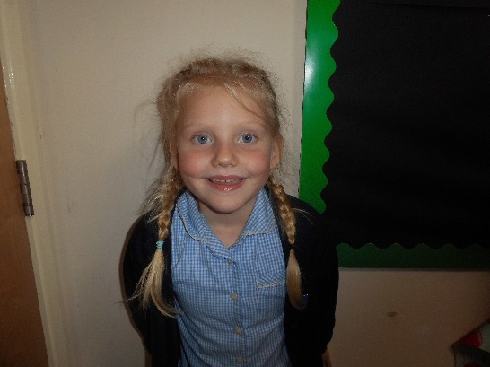
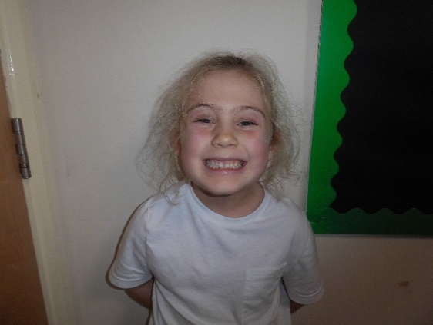
Meet our Pupil Wellbeing Ambassadors for 2023/2024
Year 1
“I am kind and caring. I can help people when they get hurt. I will talk to people who are sad about their feelings and try and make them happy.”
“I help people when they’re sad. I will offer to play if people are sad, or sit with them. I will share my ideas for wellbeing.”

Slide 5
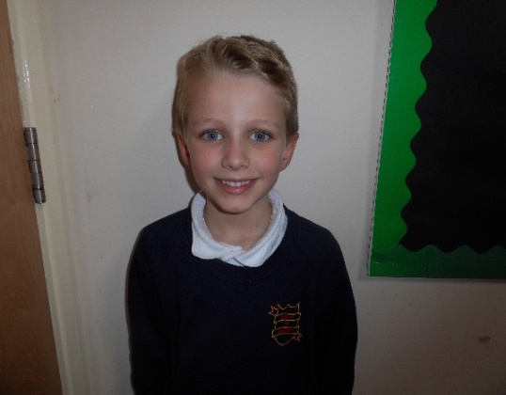
Year 2
“I am fun, have kindness and smiles! I am helpful and thoughtful. I will check that everyone is ok.”
“I am kind and funny and a good listener. I will be kind to all pupils, so they are kind to others. I will explain new wellbeing ideas to my class.”

Slide 6
Year 3
“I am kind and help people in need. I tell jokes when people are sad. I am polite and will remind people of wellbeing challenges and activities.”

Slide 7
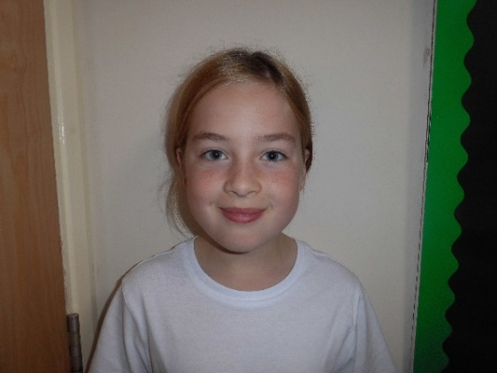
Year 4
“I am good communicator and kind. I will advise people to talk to teachers when we can’t help.”
“I can help with problems and I am kind.”

Slide 8
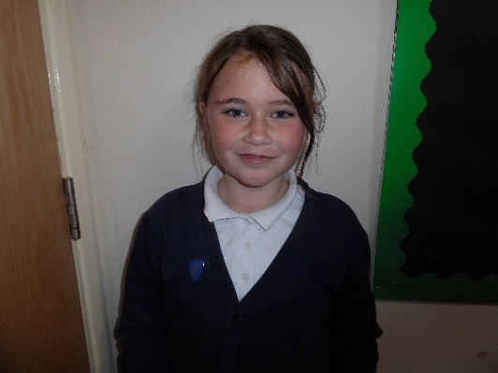
Year 5
“I’m helpful, kind and good at listening. Whenever someone is upset, I can see if they’re ok and if they’re not I’ll make them happy.”
“I let people talk and help people. I will hold doors, say hello and be nice to the teachers.”

Slide 9
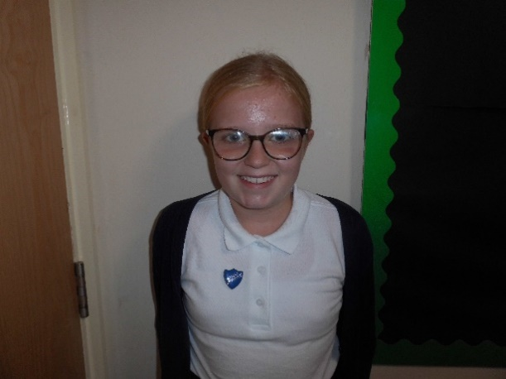
Year 6
“I will make an amazing wellbeing ambassador because I love to help. I am kind, loving and helpful.”
“I can offer kindness, support and understanding to our school. I can be available for pupils to talk to me, give a large range of ideas, support pupils in hard situations and help them to make up with their friends.”

Slide 10
Our journey so far…..
We were so proud to receive our Wellbeing Ambassador badges!
29/9/23
5/10/23
We had our first meeting and completed some initial training with Mrs Coulson and Mrs Burton.

Slide 11
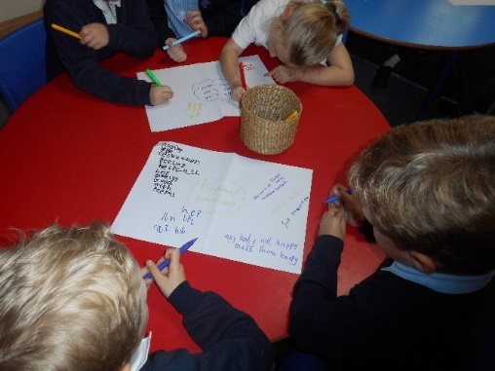
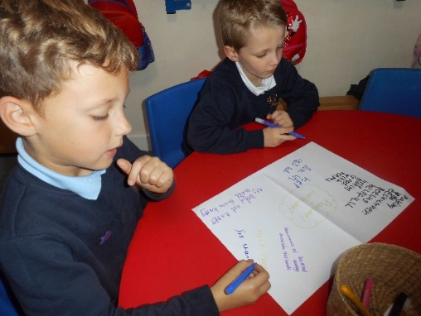
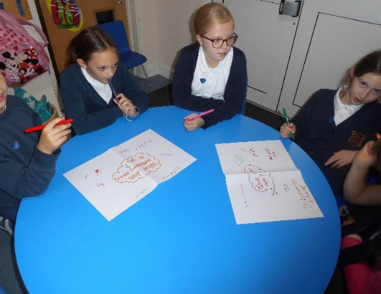
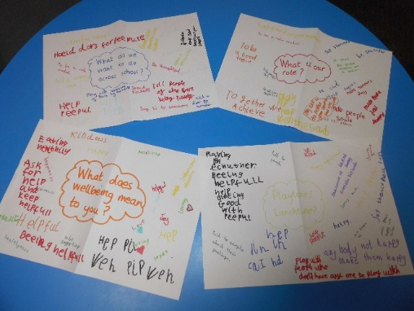
Our first meeting on 5/10/23
We talked about what wellbeing means to us, what we would like to do across school and what our role is going to be.
We thought about ideas to improve pupil’s wellbeing at school and reminded ourselves about ‘Barlby’s 10 ways to wellbeing’ which was a document that had been made by previous wellbeing ambassadors.
We went through the action plan for the year and where we were going to get started with ‘World Mental Health Day’ on 10th October.
We were given our class wellbeing books to keep safe and be in charge of. We were also given some kindness tokens to give out to start us off.
We are excited to start in our new roles!

Slide 12
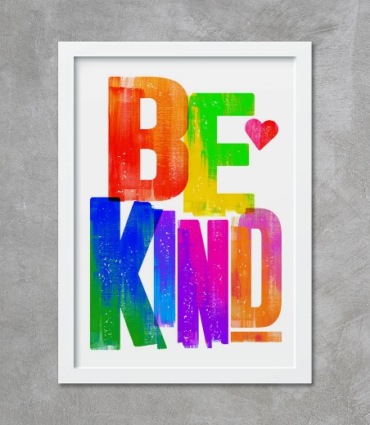
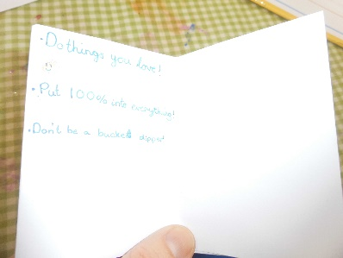
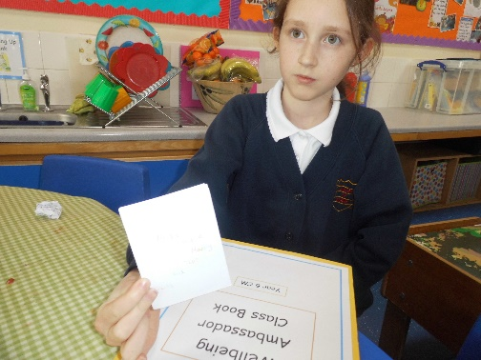
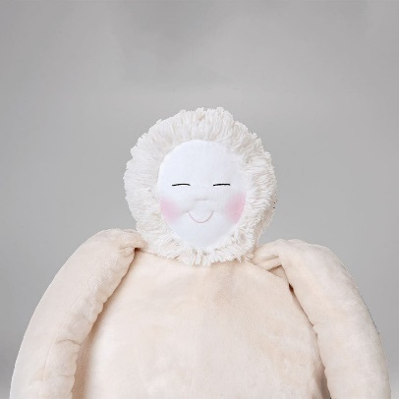
Our meeting on 9/11/23
We went through our class wellbeing books and fed back on things we had done since our last meeting to help our friends.
We discussed the wellbeing playtime club and a rota was given out to us so we knew what day we were helping and who our partner will be.
We talked about ‘Anti-bullying Week’ and ‘World Kindness Day’ which is coming up later this month and what we would be doing to mark these two events.
We learned that we would be making a visit to Abbey Lea care home in December and making Christmas cards to give out to the residents. We also discussed the fundraising to buy a ‘Hug Doll’ for Abbey Lea.
We were given some ‘kindness tokens’ to give out to our friends and had to choose one random act of kindness to do before our next meeting.

Slide 13
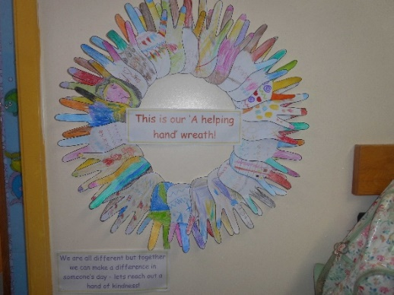
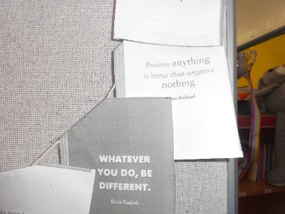
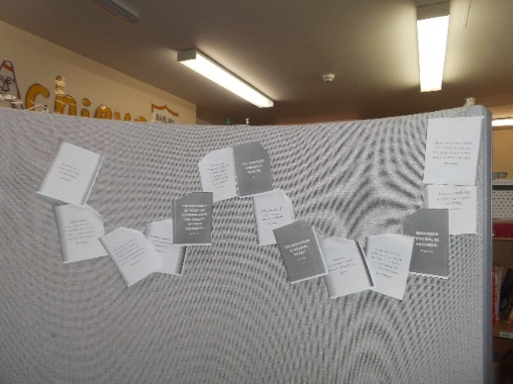
Anti-bullying Week
We had a whole school assembly on the 13th November to kick start ‘Anti-bullying Week.’ We wore odd socks to celebrate what makes us all unique, and to show that it is ok to be different and to stand up against discrimination.
Each class did some activities across the week to learn about the benefits of kindness and promote a culture which celebrates differences in our peers.

Slide 14
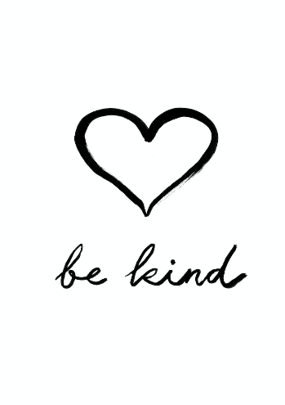
World Kindness Day
On the 13th November we celebrated World Kindness Day. Being kind is the best thing you can be, and we actively promote kindness at Barlby CP School, especially with the work the pupil wellbeing ambassadors do throughout the year. To spread the word even further about the importance and impact kindness has on our physical and mental health, here is a fantastic resource you may wish to use. Families can join the School of Kindness Kid’s Kindness Club for free here: https://schoolofkindness.org/kids-club You will find lots of helpful resources, kind stories, inspiration, competitions and you can even earn a special kindness badge.

Slide 15
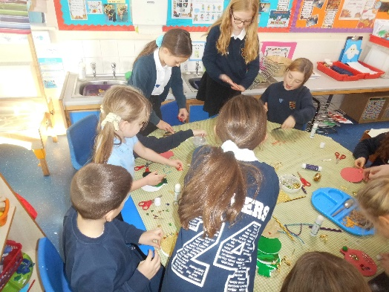
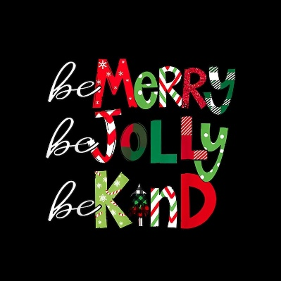
Our meeting on 30/11/23
We went through our class wellbeing books and fed back on things we had done since our last meeting to help our friends.
We discussed the wellbeing playtime club and how it was going.
We talked about our fundraising last week and how we had been able to buy not one but three hug dolls for Abbey Lea!
We got in to the festive spirit and made the Christmas cards for our visit to Abbey Lea next week which we are very much looking forward to.

Slide 16
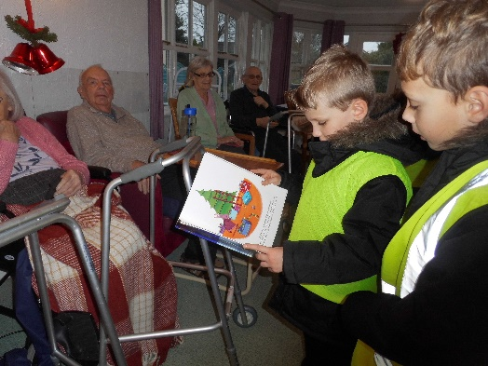
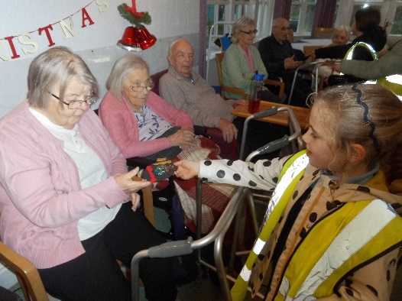
Our visit to Abbey Lea on 7/12/23
We were in the festive spirit today ready to deliver our cards to Abbey Lea care home!
We read some Christmas stories to the residents and also sang some Christmas songs.
We were able to deliver the three ‘hug’ dolls we had raised money to buy and the residents and staff were delighted with them!
What a lovely afternoon we have all had. We look forward to hearing how the residents get on with the ‘hug’ dolls!
To find out more about ‘Hug’ dolls please visit https://hug.world/

